Slide 1
Software Engineering Practice Week 5

Slide 2
Project Plan –Tutoring 3
week | Iteration | Start Date | End Date | Release
Week 4 | Iteration 0 | 13/08/2018 | 19/08/2018 | 1
Week 5 | Iteration 1 | 20/08/2018 | 27/08/2018 | 1
Week 6 | Iteration 2 | 27/08/2018 | 2/09/2018 | 1
Week 7 | Iteration 3 | 3/09/2018 | 9/09/2018 | 1
week | Iteration | Start Date | End Date | Release
Week 8 | Iteration 1 | 10/09/2018 | 16/09/2018 | 2
Week 9 | Iteration 2 | 17/09/2018 | 23/09/2018 | 2
Week 10 | Iteration 3 | 24/09/2018 | 2/10/2018 | 2
Week 11 | Iteration 4 | 3/10/2018 | 9/10/2018 | 2
Week 12 | Iteration 5 | 10/10/2018 | 17/10/2018 | 2
Assignment 1
Show Case
Assignment 2
Show Case

Slide 3
Java Development Track

Slide 4


1-Aspect Oriented Programming
2-Spring Boot Programming

Slide 5
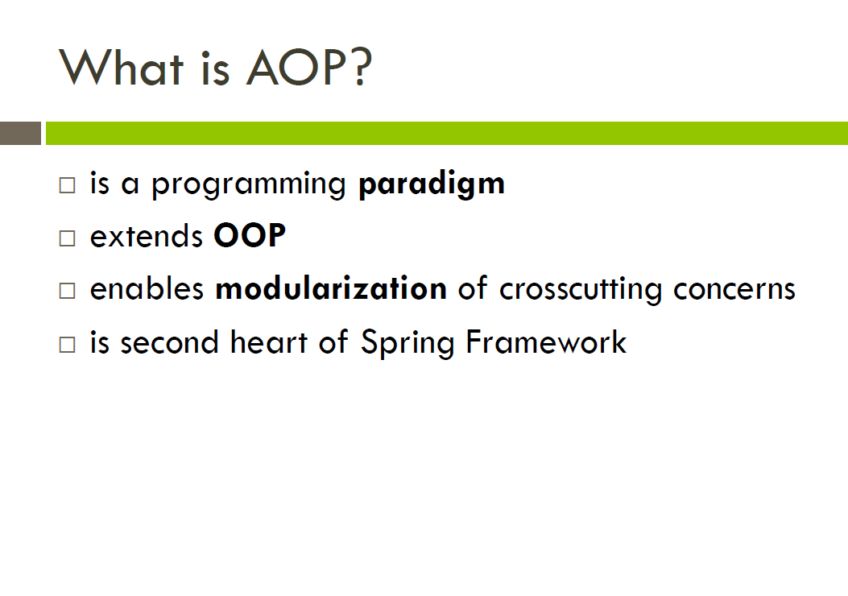

Slide 6
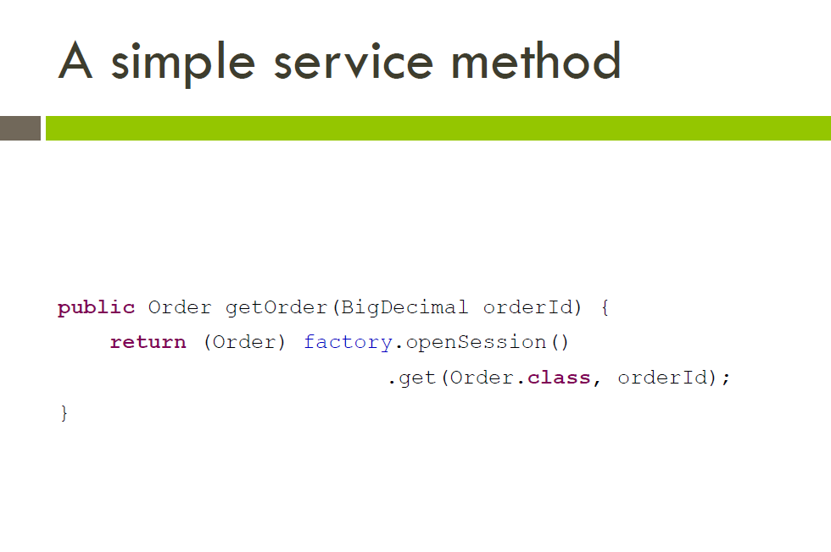

Slide 7
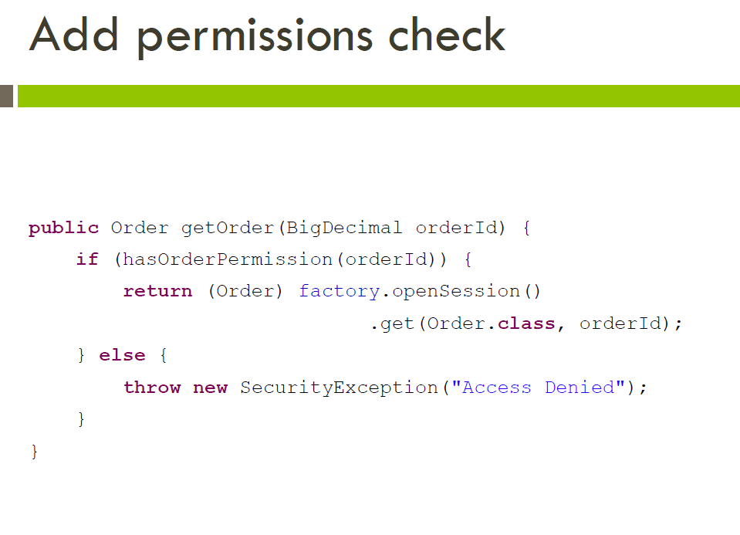

Slide 8
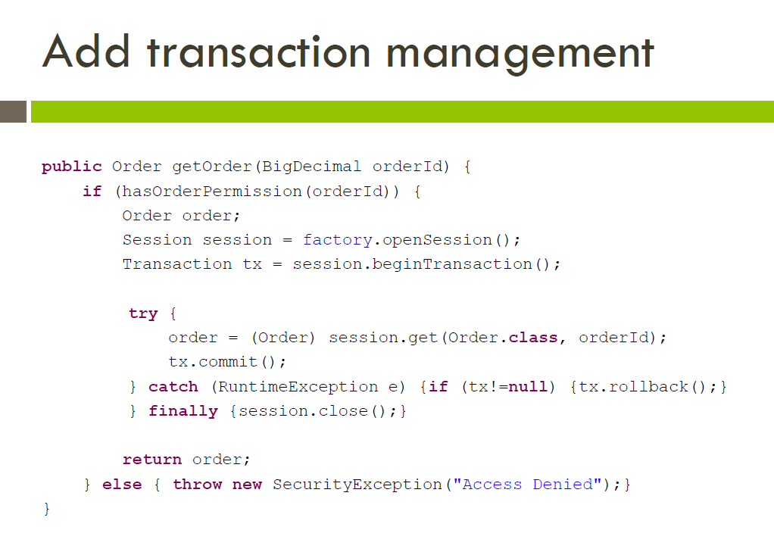

Slide 9
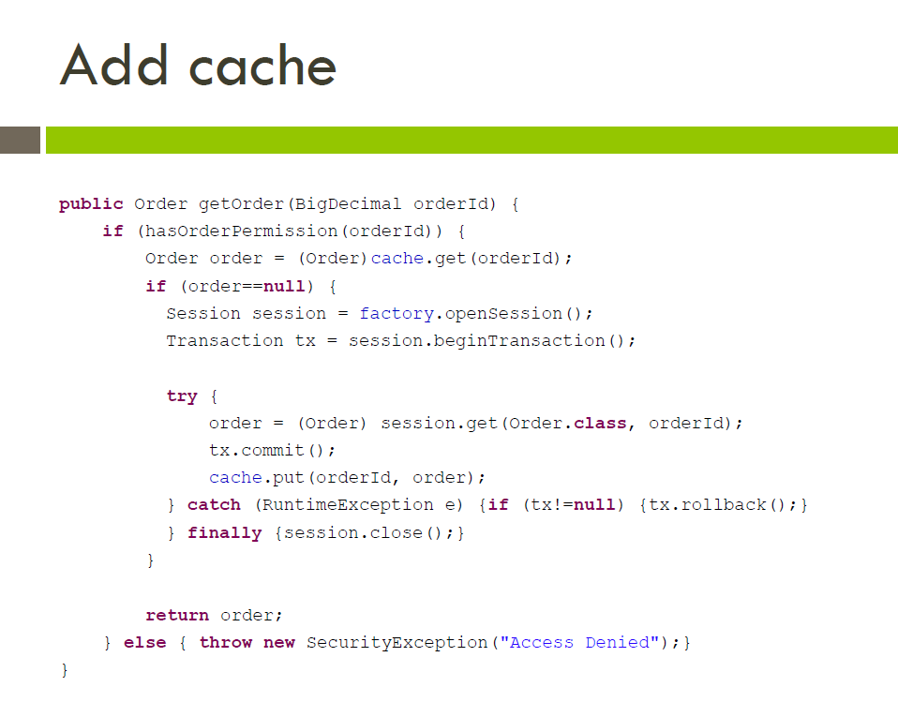

Slide 10
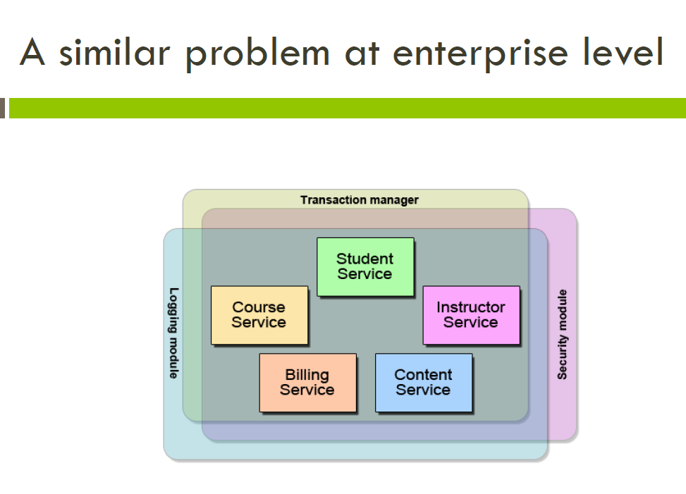

Slide 11
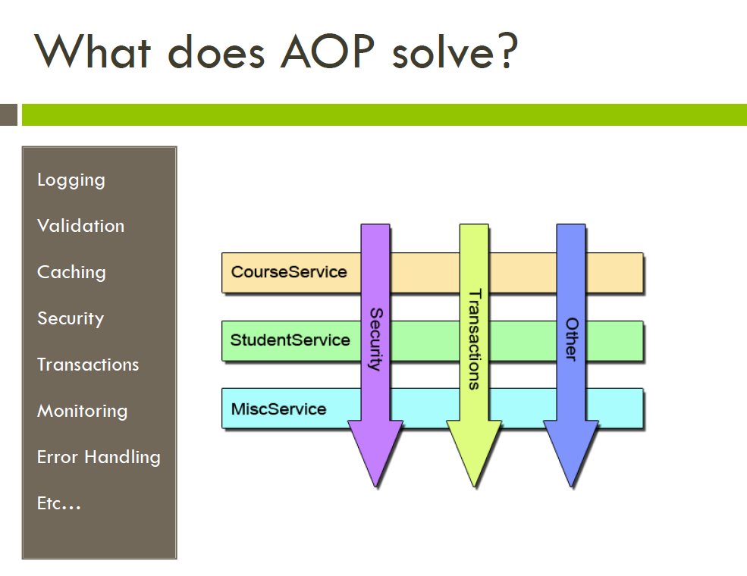

Slide 12
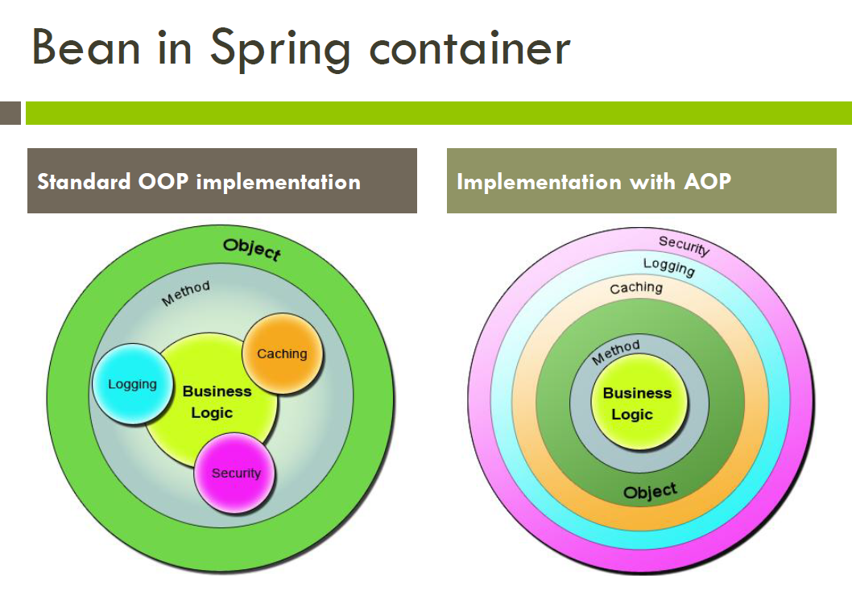

Slide 13
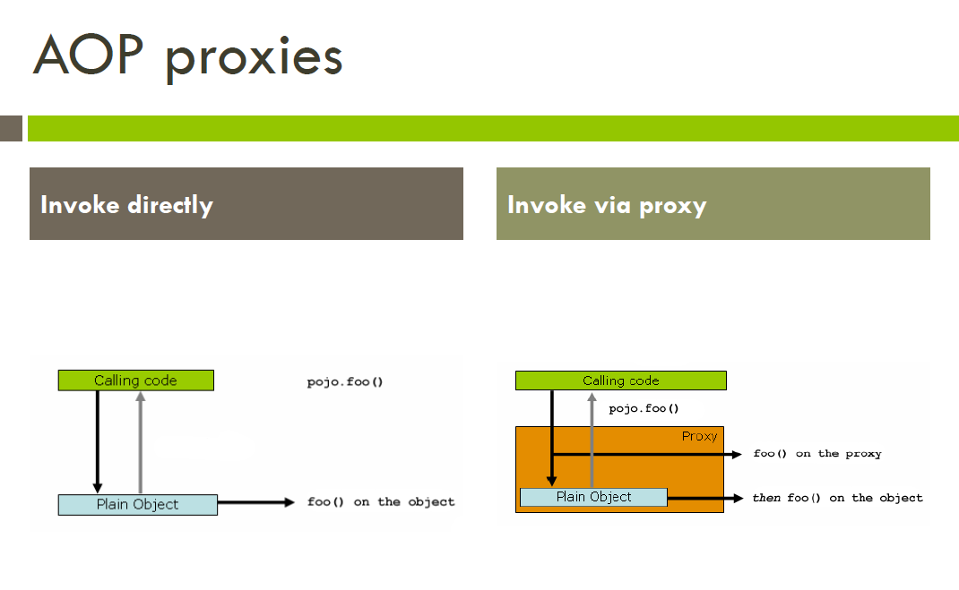

Slide 14
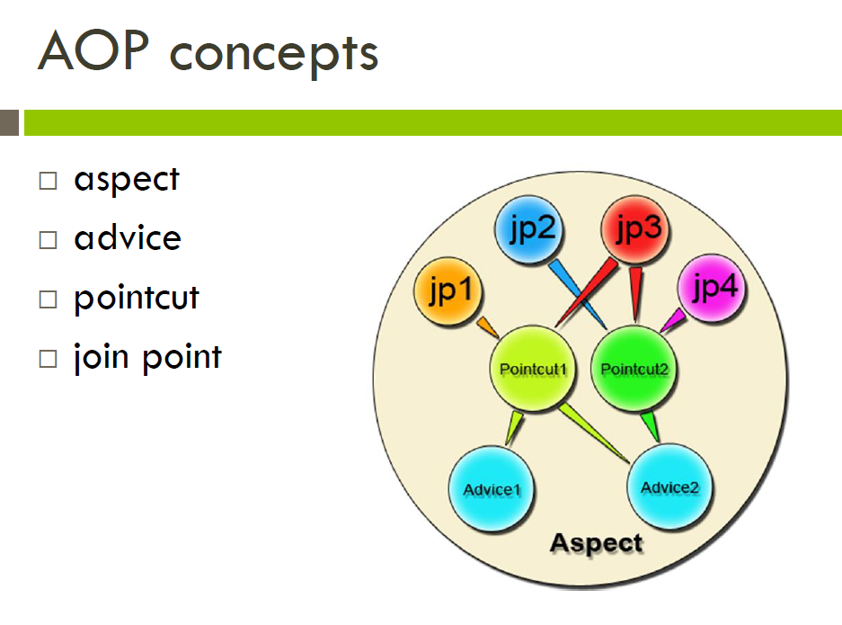

Slide 15
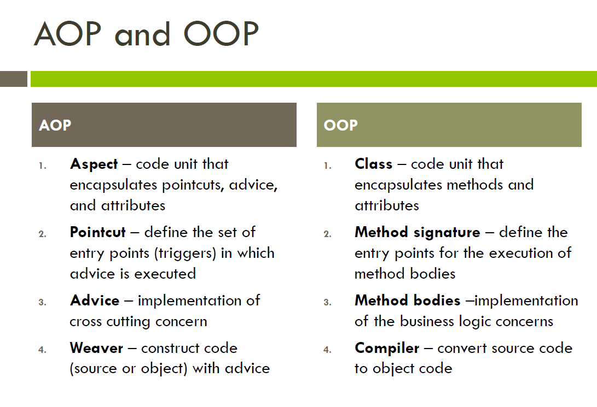

Slide 16
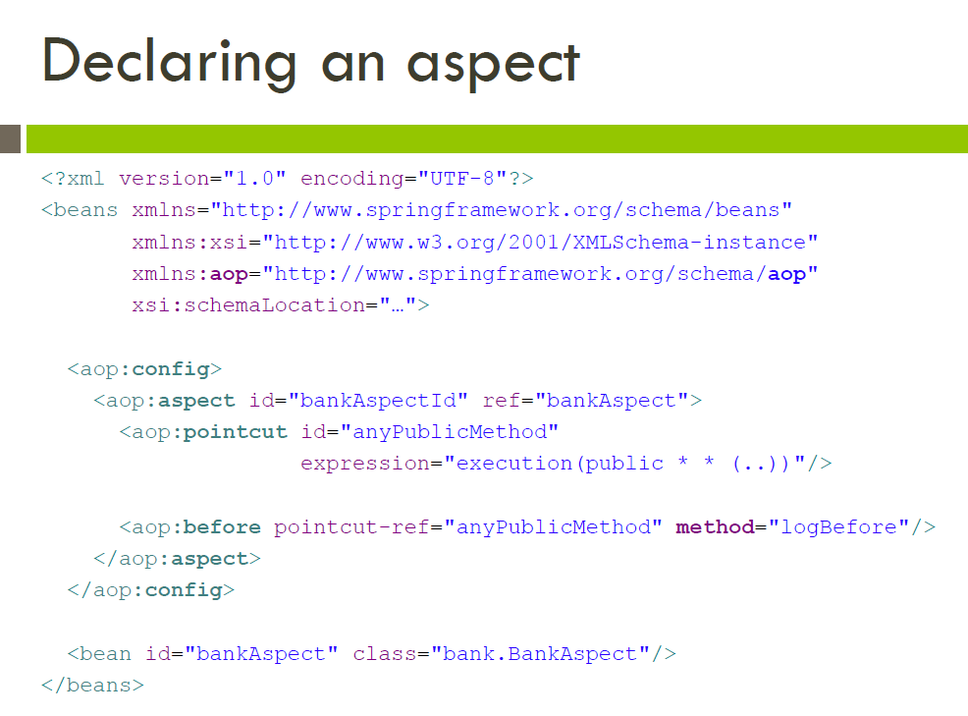

Slide 17
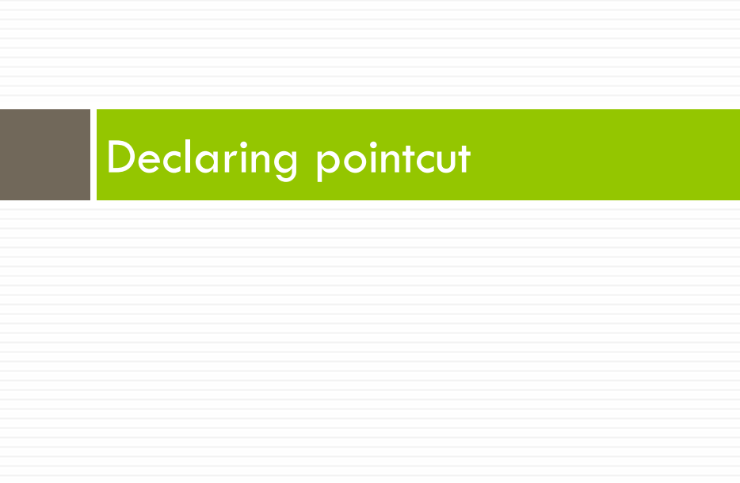

Slide 18
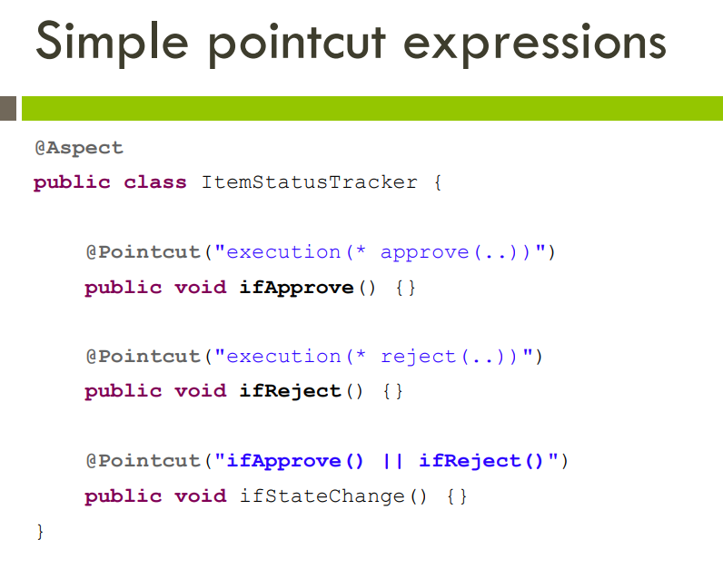

Slide 19
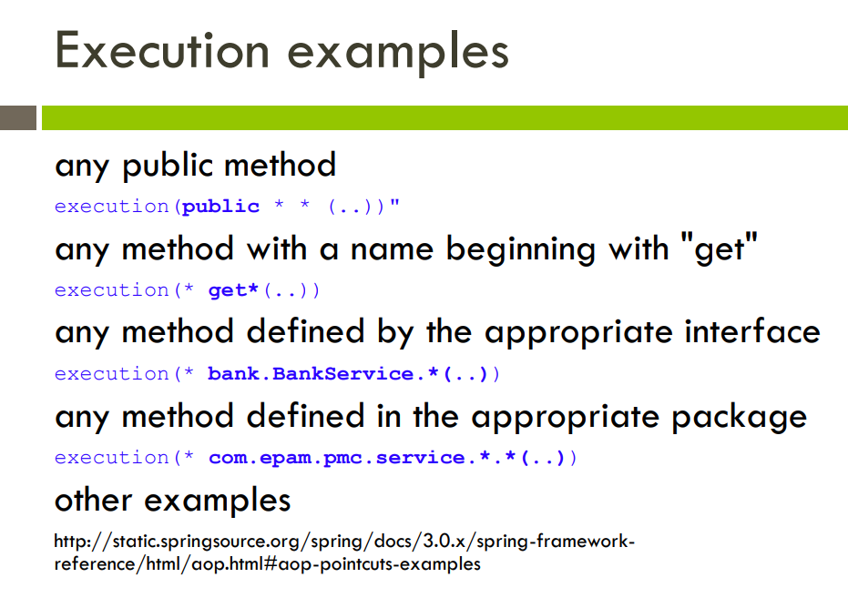

Slide 20
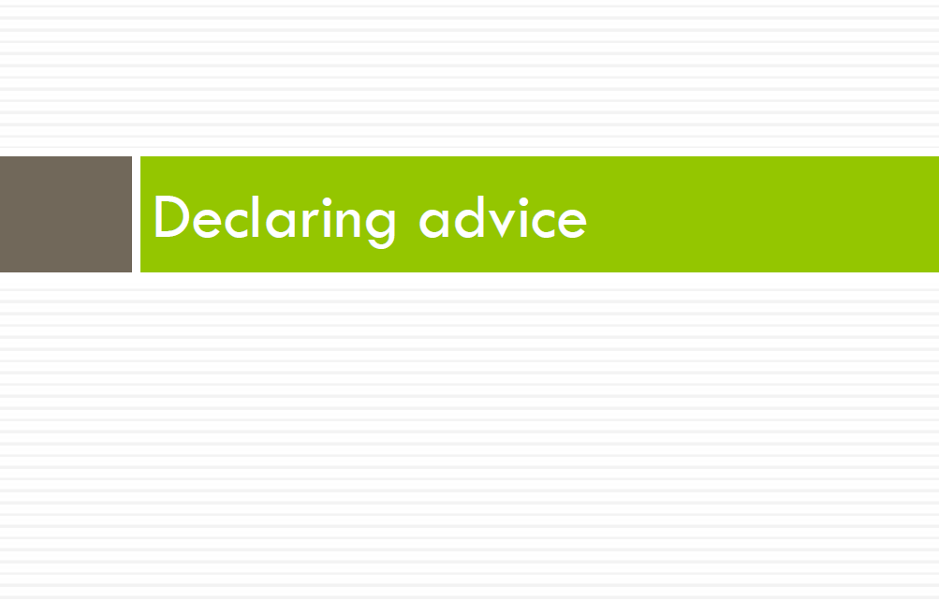

Slide 21
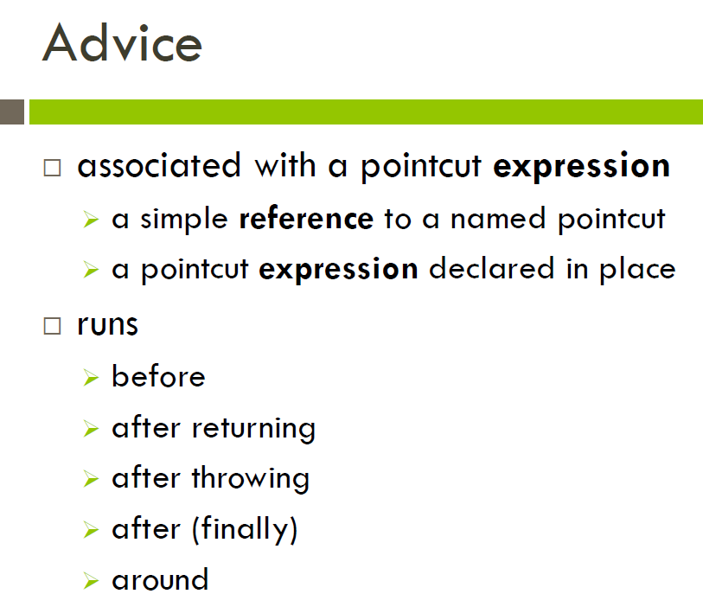

Slide 22
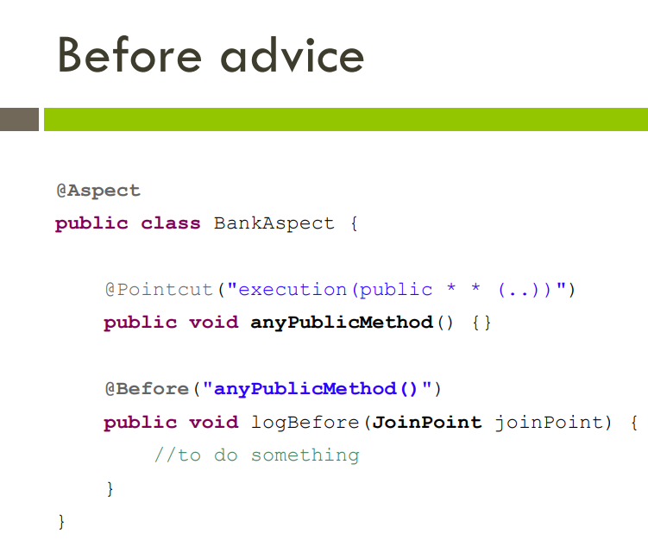

Slide 23
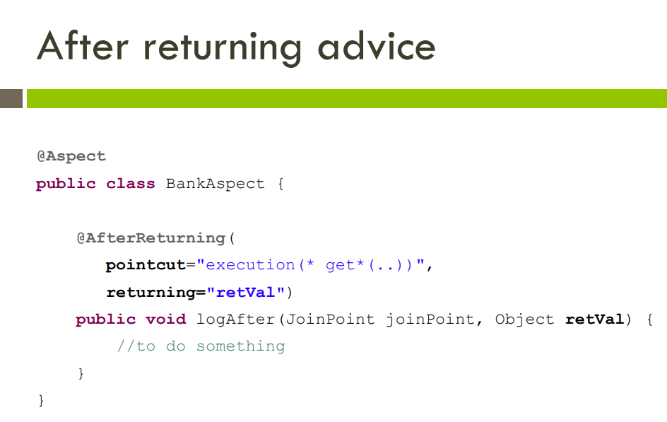

Slide 24
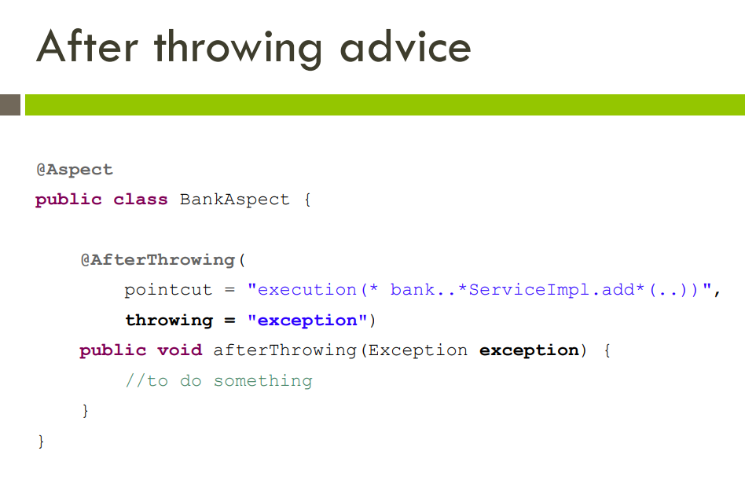

Slide 25
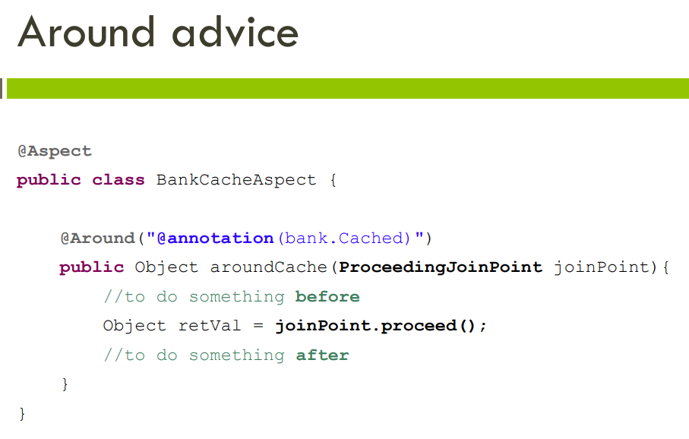

Slide 26
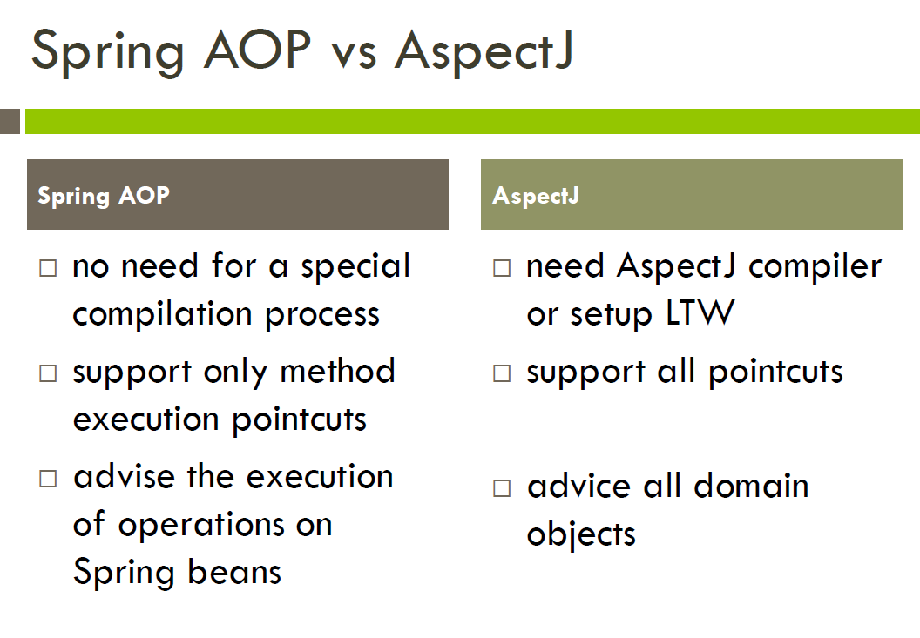

Slide 27
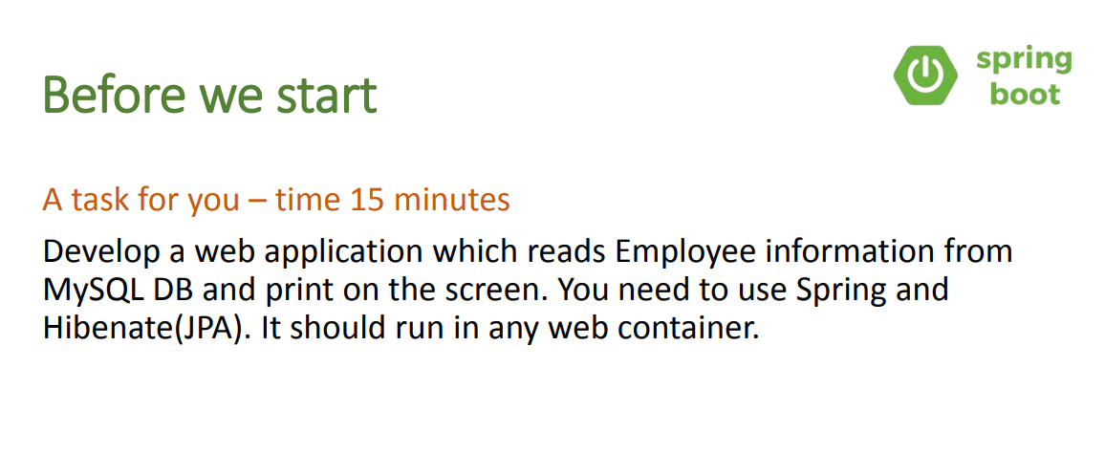

Slide 28
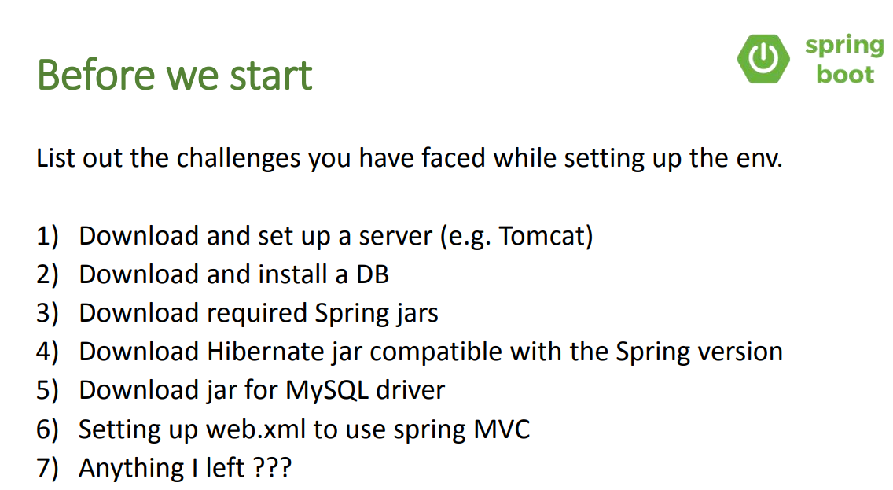

Slide 29
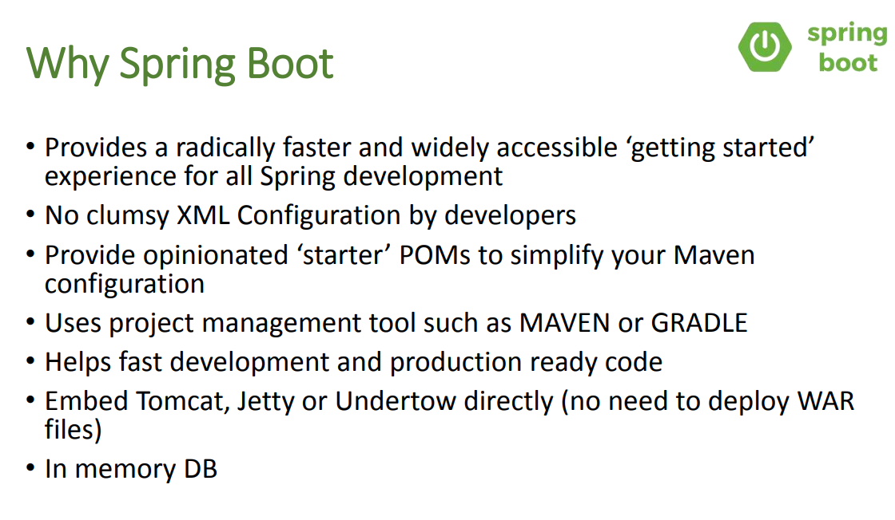

Slide 30
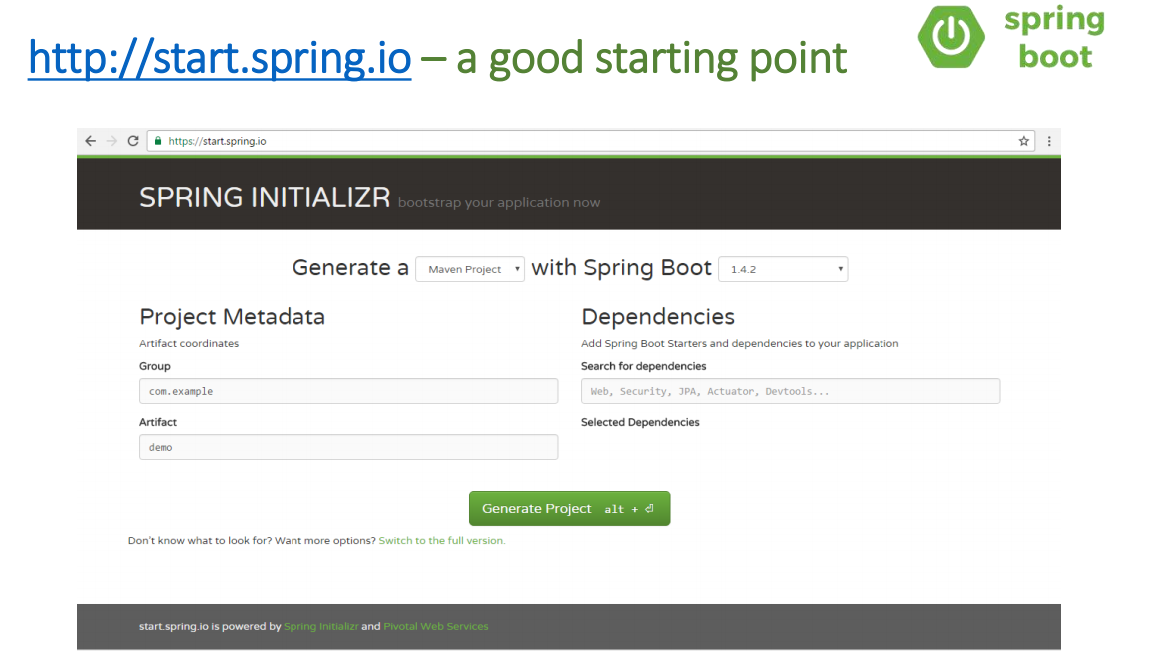

Slide 31
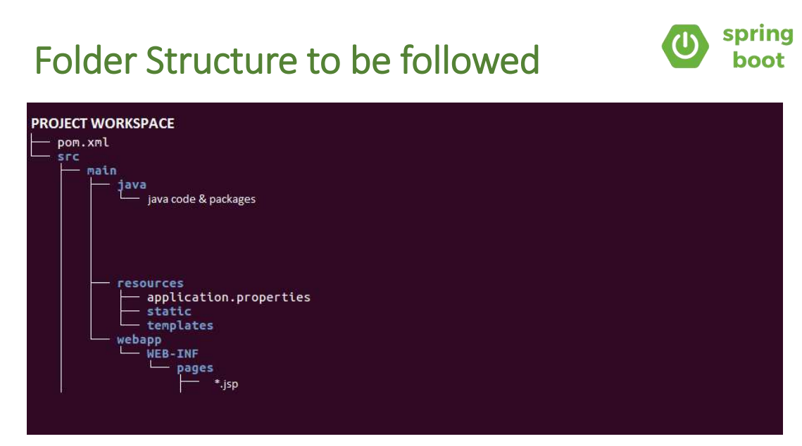

Slide 32
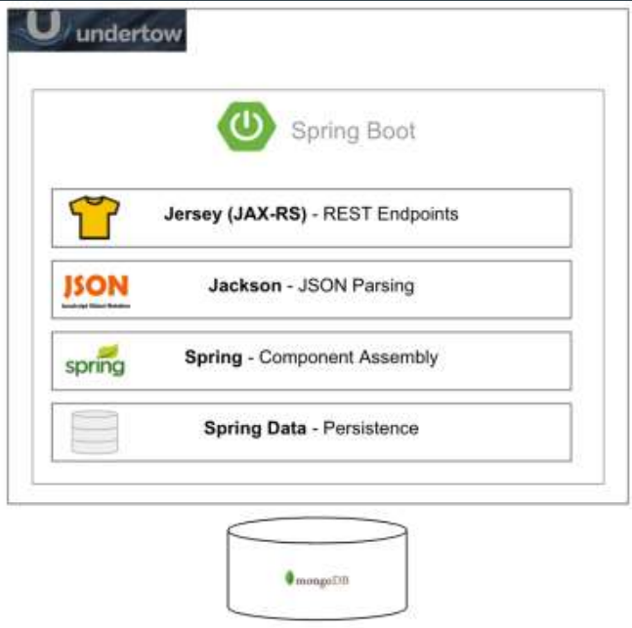
Spring Boot

Slide 33
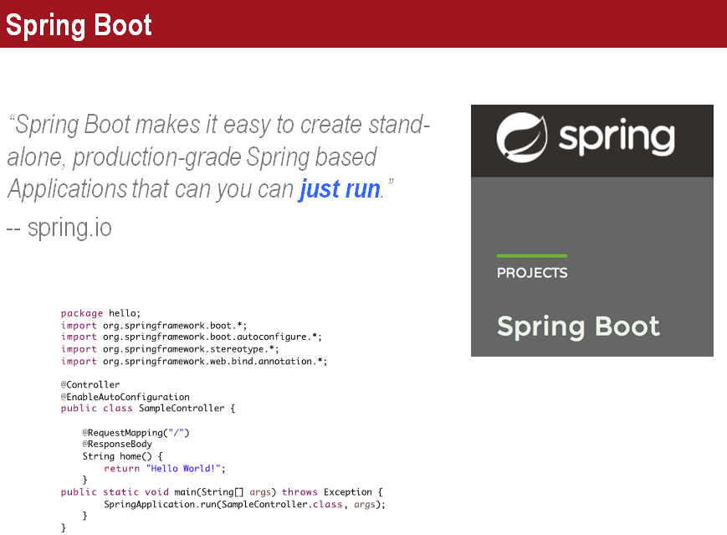

Slide 34
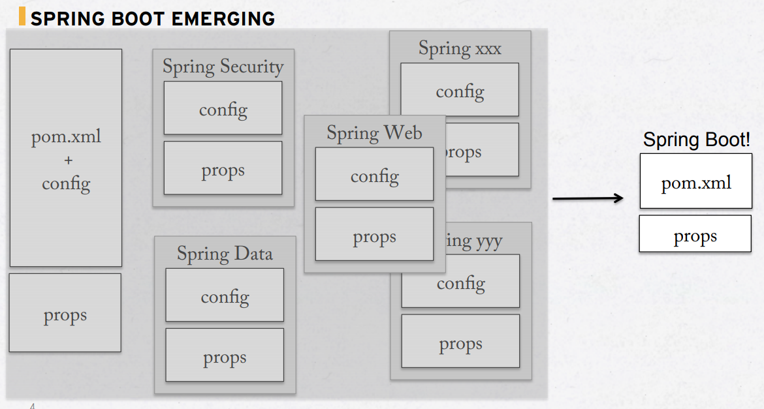

Slide 35
● Dramatically reduces boilerplate code
● Enables polyglot
● Simplifies integration testing
● Simplifies environment maintenance

Slide 36
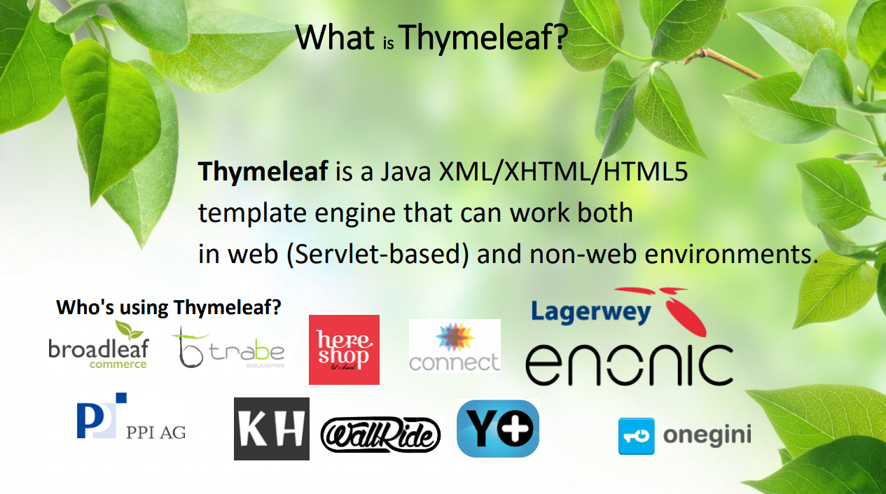

Slide 37
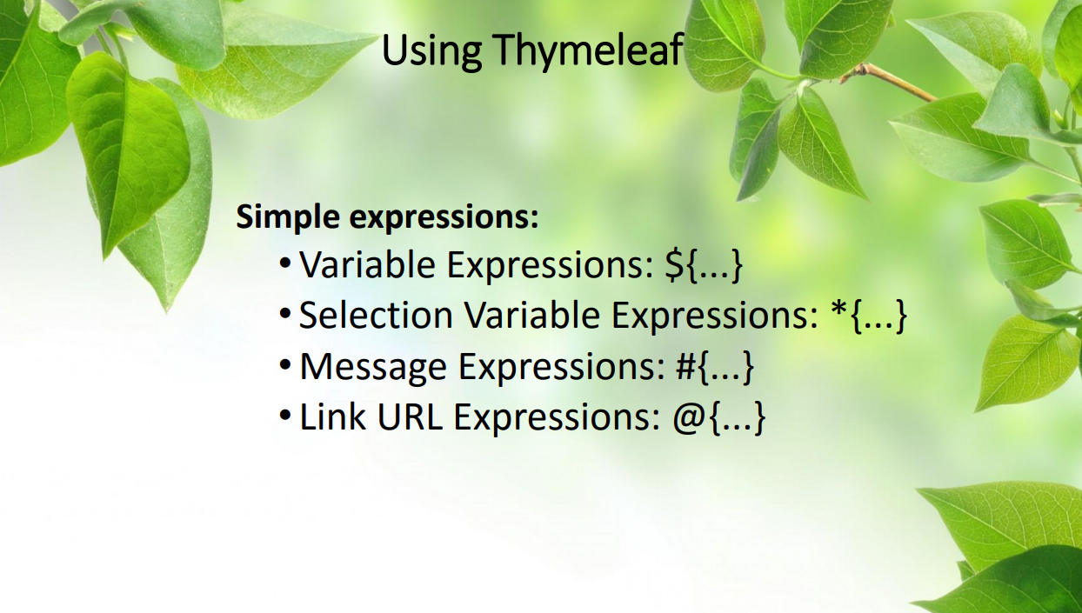

Slide 38
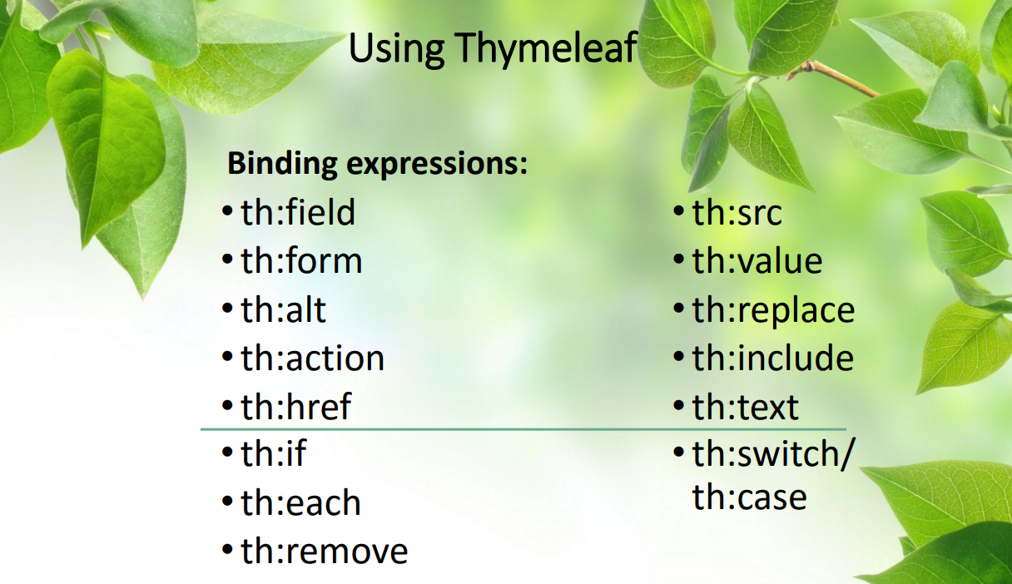

Slide 39
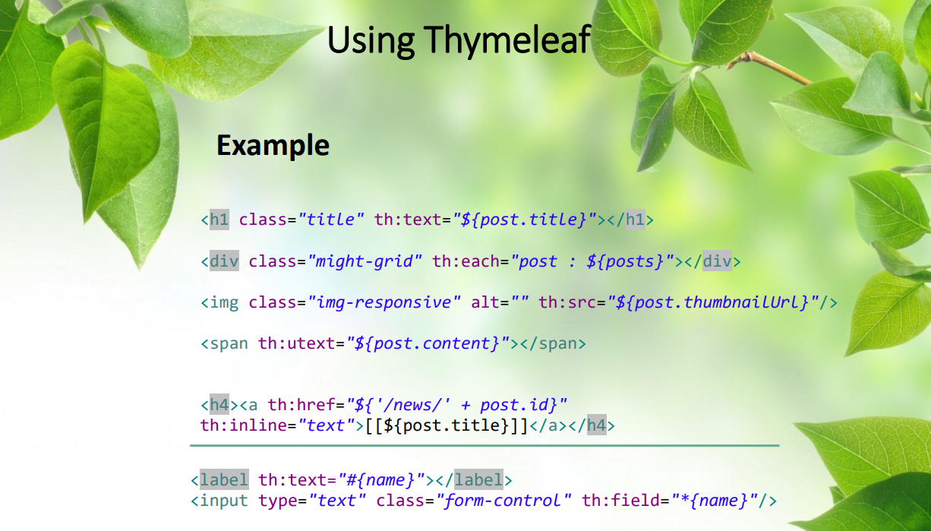

Slide 40
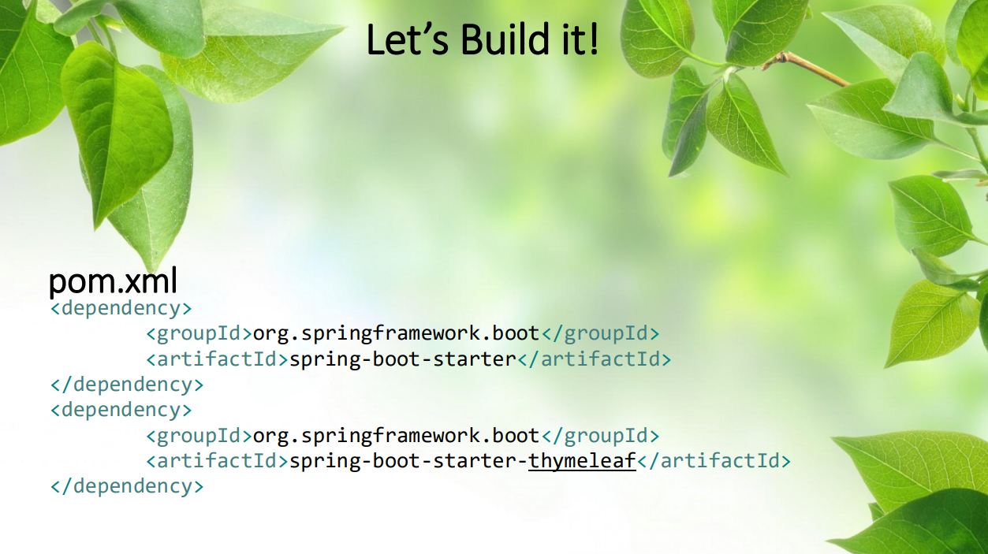

Slide 41
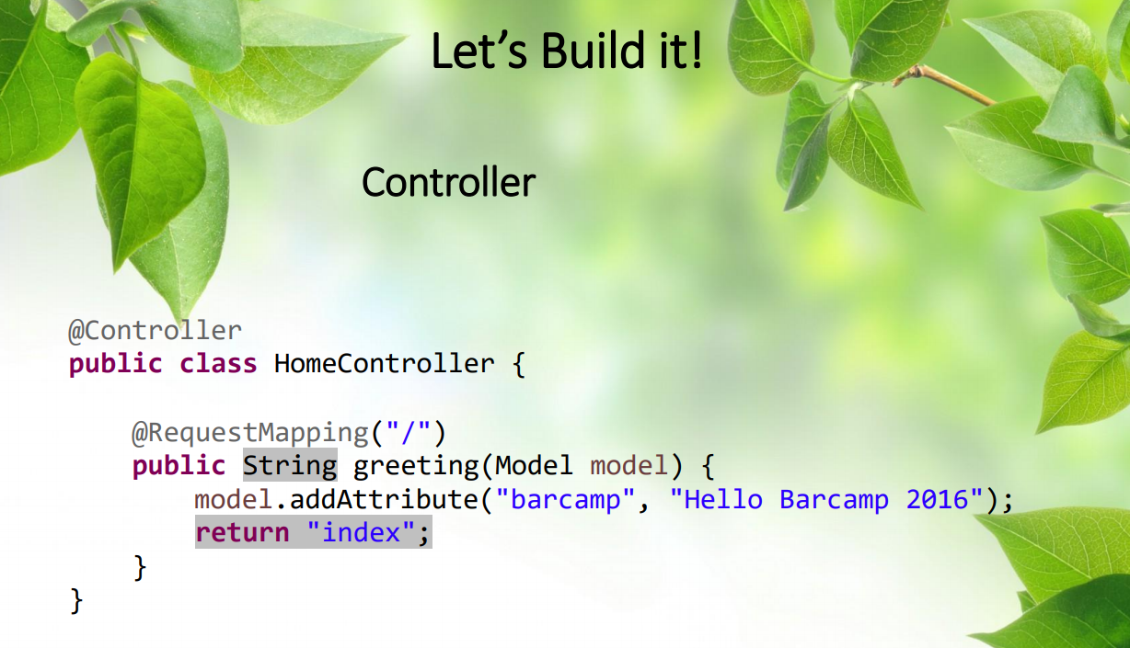

Slide 42
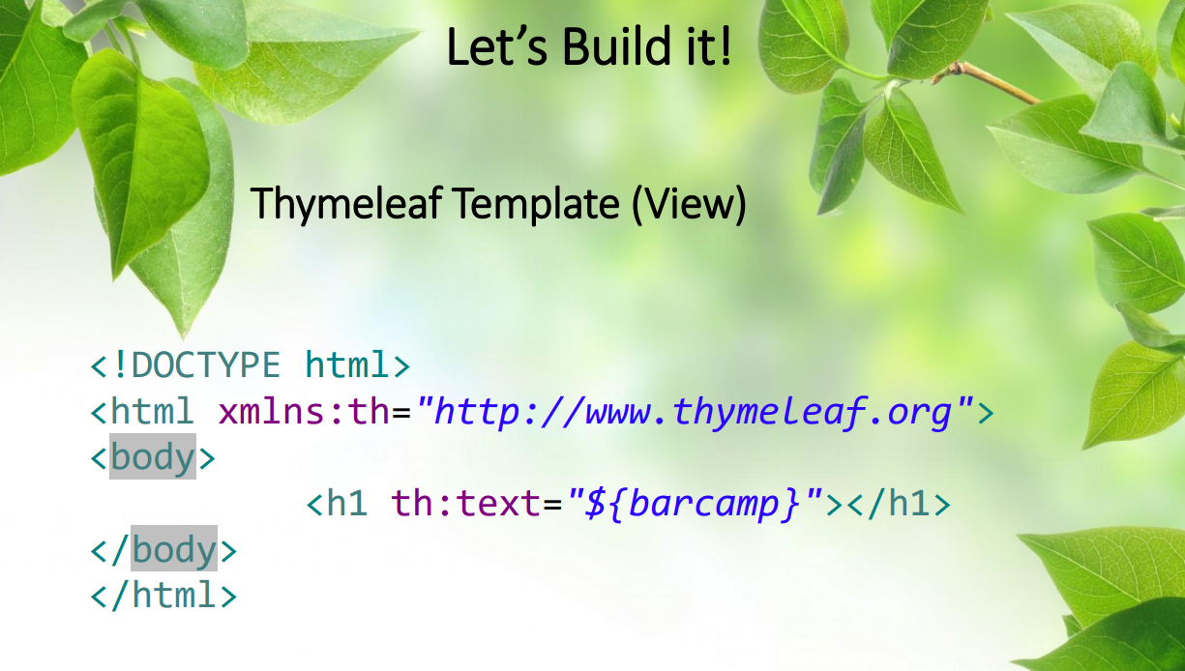

Slide 43
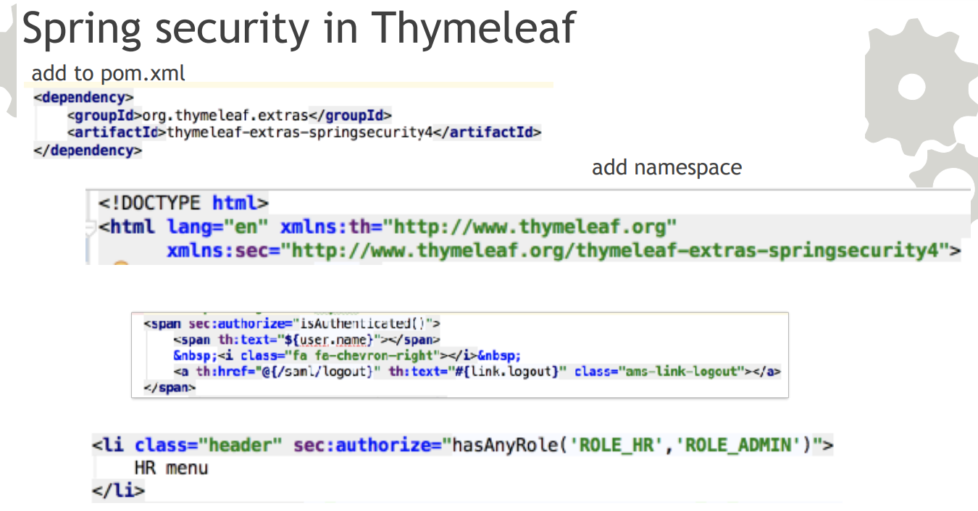

Slide 44
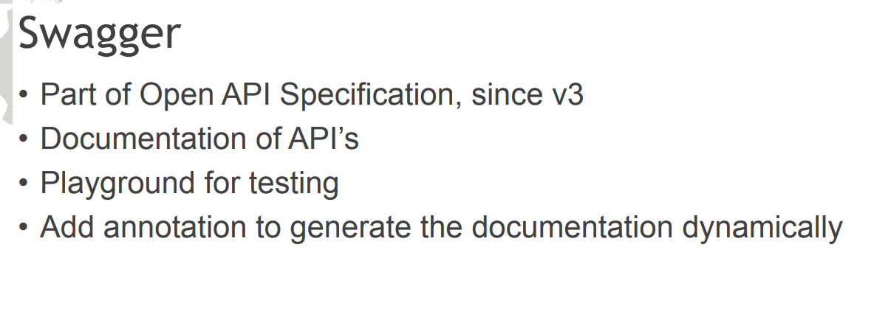
Add-ons lib on Spring boots

